Slide 1



StaffCorps
Feature 02-01
View Latest News
Feature 03-02
Read about the top-headlines of today
Feature 02-02
SG Road Traffic
Search Existing News
View real-time road traffics
Search for news with a topic
Feature 01
Feature 03-01
Optical Character Recognition, OCR
SG Weather Forecast
Convert an image to text
Get the current weather forecast

Slide 3


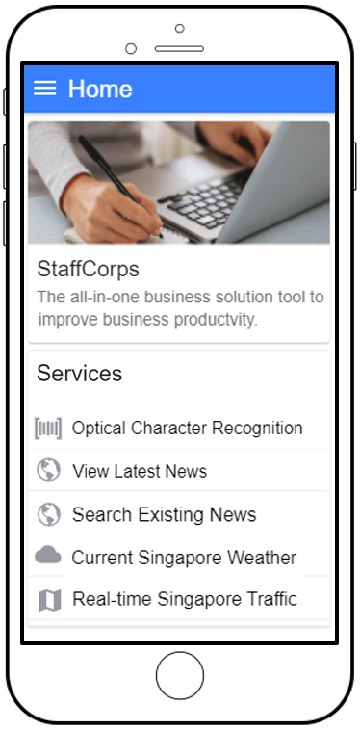


StaffCorps
The All-in-one
Business Solution
Progressive-Web-App
Stop typing out documents,
Just copy and paste
Be up-to-date,
Don’t let competitors be ahead
Be trendy,
Know about today’s business
Get weather reports,
Don’t fall victim to the rain
View real-time road traffic images,
Don’t be late for work
By: Tan Wei Jun, Terris

Slide 4

